Slide 1
Managing Corrosion- An Engineered Solution for Electronic and Mechanical Assemblies

Slide 2
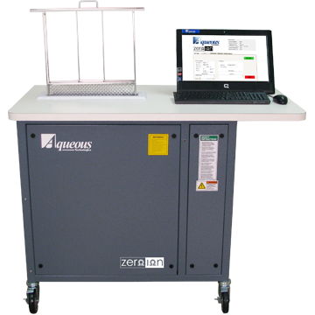
Cleaning and Unit Preparation
DI Water Wash
Some Hardware; Water Soluble Fluxes
Aqueous Cleaning (water + chemicals)
Optimal for Hardware; Most Fluxes including No Clean
Solvent Cleaning
Optimal for Hardware; RMA, Rosin, No Clean Fluxes, Oils
Ultrasonic
Increase Effectiveness of Standard Methods
Mechanical – brushing & wiping

Slide 3
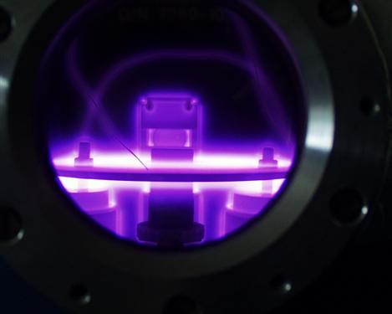
Plasma Treatment and Surface Activation
Dry Process
Environmentally Friendly
High Efficiency
Reduced Waste Stream
Removal of Contaminants
Modify Surface Energy
Increased Material Substrate Options
Teflon, Plastics
Increased Adhesion and Wettability

Slide 4
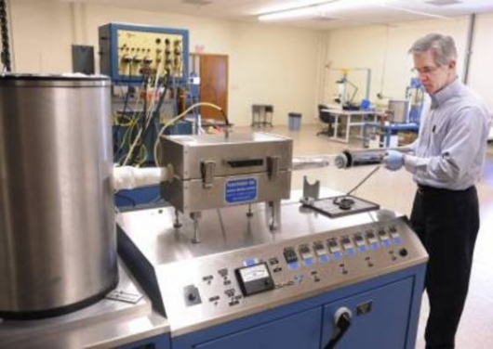
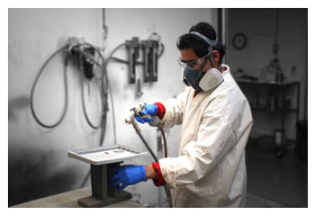
Application Methodology
CVD-Chemical Vapor Deposition
Truly Conformal
Dip coating
Spray
Multi faceted approach
Increased Efficiency
Layered approach
Optimized Material Performance
Example: Parylene with Urethane Overcoat

Slide 5
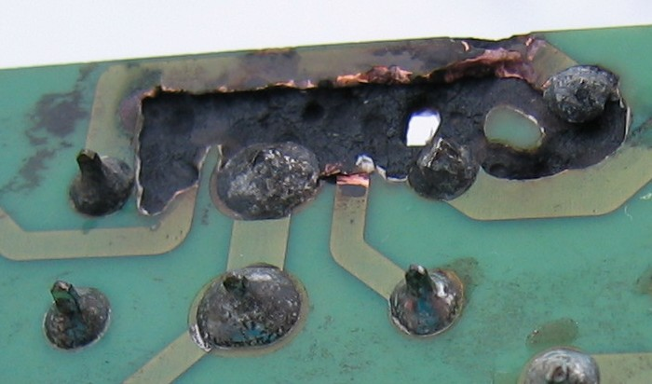
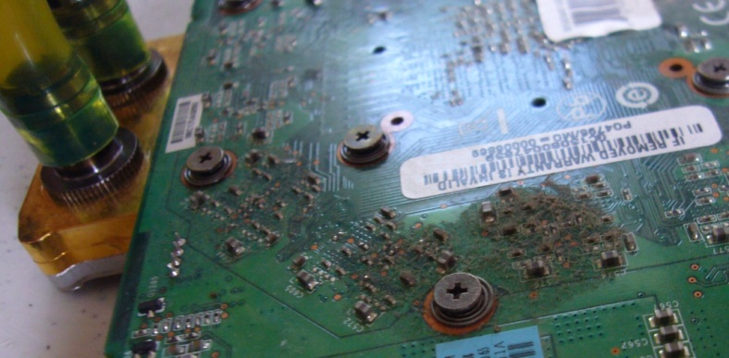
Preferred Materials
Conformal Coating for Enhanced Corrosion Resistance

Slide 6
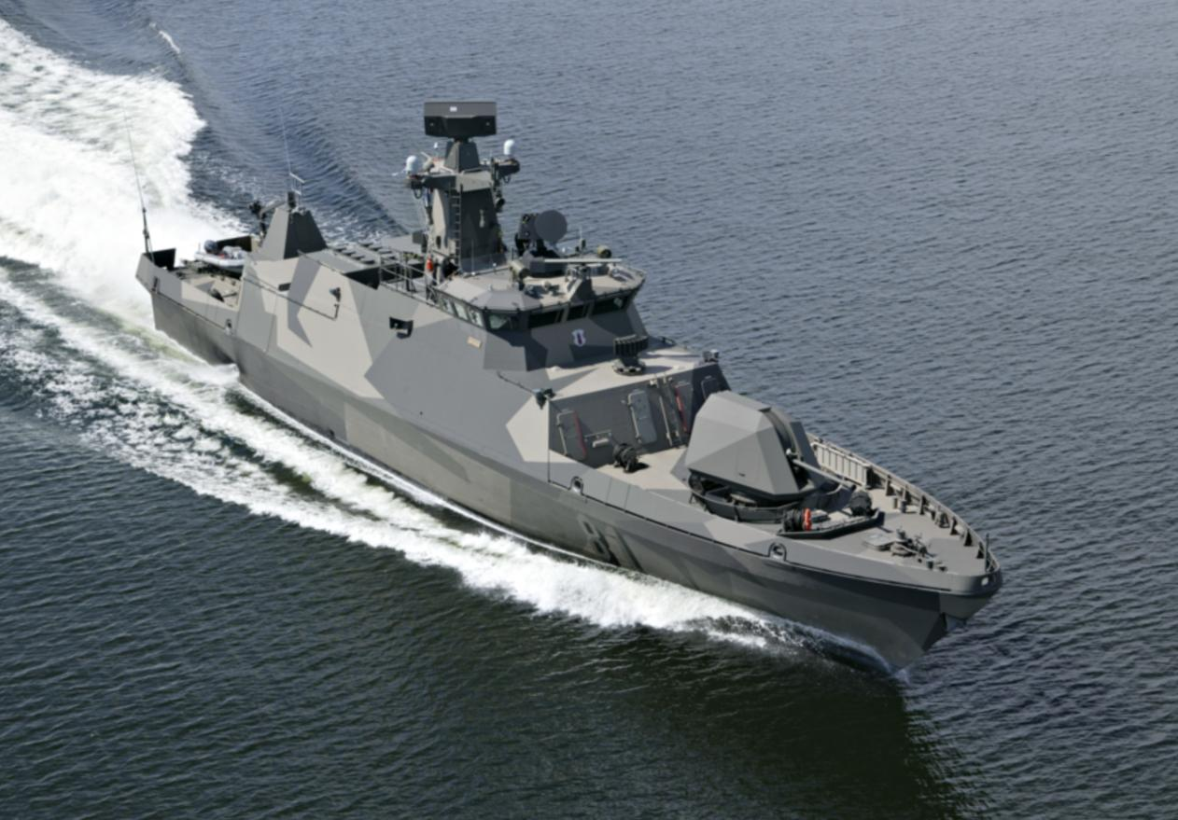
Parylene
Excellent Chemical Resistance
Excellent Electrical and Mechanical Properties
Protection from Corrosion
Low Stress
Thin Film

Slide 7
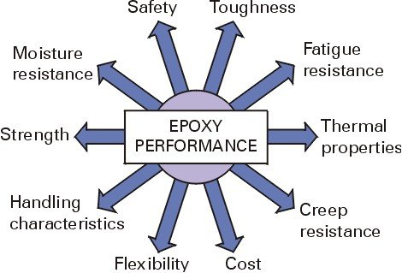
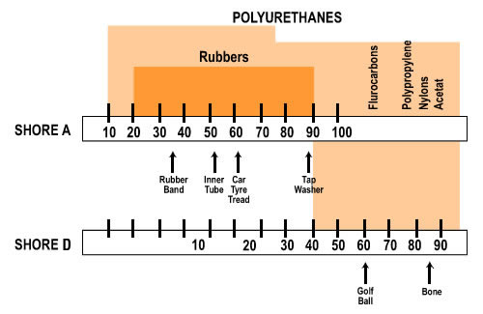
EPOXY and URETHANE
Great Material Compatibility
Good to Excellent Chemical Resistance
Ideal for harsh environments
Moisture, Fluids, Corrosive Gases
Good to Excellent Abrasion Resistance
Thermo-mechanical Stability
Tunable
Mix Ratios, Additives/Fillers
Greater Control of Physical and Electrical Properties

Slide 8
Acrylics & Silicones
Low Stress
Good RF compatibility (Low Dielectric K)
Ideal material for antenna
Reduced Process Complexity
Easily Reworked /repairable

Slide 9
Nano Technology
Inorganic Coatings (ASG)
High Operating Temperature Limits
Thin Film

Slide 10
Material Selection Table
 |  |  |  |  | Rating Scale 1 (Highest) to 4
 | Acrylic | Polyurethane | Epoxy | Silicone | Parylene (XY)
 | (AR) | (UR) | (ER) | (SR) | C | D | N
Humidity Resistance | 2 | 1 | 2 | 1 | 2 | 2 | 1
Humidity Resistance (Extended Periods) | 2 | 1 | 3 | 2 | 2 | 2 | 1
Abrasion Resistance | 3 | 2 | 1 | 4 | 1 | 1 | 1
Mechanical Strength | 3 | 1 | 1 | 2 | 1 | 1 | 1
Temperature Resistance | 2 | 3 | 3 | 1 | 2 | 2 | 1
Acid Resistance | 3 | 1 | 1 | 2 | 1 | 1 | 1
Alkali Resistance | 3 | 1 | 1 | 2 | 1 | 1 | 1
Organic Solvent Resistance | 4 | 1 | 1 | 2 | 1 | 1 | 1
Dielectric Constant (1MHz @ 23°C) | 2.2 - 3.2 | 4.2- 5.2 | 3.3 - 4.0 | 2.6 - 3.0 | 3.15 | 2.84 | 2.65
Outgassing | 3 | 2 | 3 | 4 | 1 | 1 | 1
Electrical Impedance | 2 | 4 | 3 | 2 | - | - | -
Optical Clarity | 4 | 3 | 1 | 2 | 2 | 2 | 2
Electrical Insulation | 1-2 | 1-2 | 1-2 | 2 | 2 | 2 | 1
Reworkability | 1 | 3 | 3 | 2 | 4 | 4 | 4
VOC’s | 1-3 | 2-3 | 2-3 | 1-2 | 1 | 1 | 1
Thermal Stability | 1-2 | 2 | 2 | 1-2 | 1 | 1 | 1
Thermal Conductivity | 2-3 | 1-3 | 1-3 | 2-3 | 3 | 3 | 3
Adhesion | 2-3 | 1-2 | 1-2 | 1-3 | 2 | 2 | 2

Slide 11
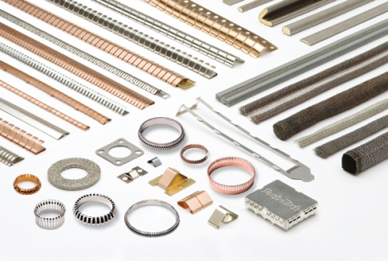
EMI RFI Shielding

Slide 12
FIPG (Form-In-Place Gasket)
FORM-IN-PLACE conductive gaskets offer effective EMI RFI shielding, ESD control and environmental seal.
Multi-Axis CNC dispensing for precise, repeatable, high reliability sealing.
Capable of mitigating Internally or Externally radiated interference.
Can be applied to nearly all conductive surfaces where a seal is required including conductive coated or metallized composites.

Slide 13
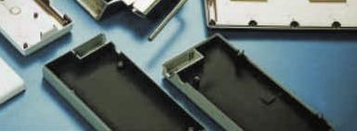
Conductive Coatings
Coatings are typically applied to hardware or electronics through spray application or CNC dispensing.
Excellent EMI RFI shielding
High Attenuation
Adaptable material properties

Slide 14
Nano Technology
Optically Clear Material Solutions Available
Ideal for Lighting Solutions (LED)
Can Replace ITO (Indium Tin Oxide)
Applied Easily Using Conventional Methodologies
Spray
Dip

